Slide 1

Online Newspaper System

Slide 2

Hello!
Project Presentation by
SHUBHAM SANJAY SONAR
Roll no.21258
Seat no. 21113

Slide 3
Project Developed by
Back-End : Python
Front-End : html, CSS,JavaScript
Hardware
Hard disk up 1.8GB, RAM:16mb or above, Windows10
Software
VS Code, MySQL,
Any Browser

Slide 4
Index
Introduction
Scope
System Analysis & Design
E-R Diagram
Use Case Diagram
Class Diagram
Activity Diagram
Data Dictionary
User Interface Design
Conclusion
Post Implementation
Limitation
References

Slide 5
Introduction
1

Slide 6
Digital newspaper always stays ahead in the game because it remains updated throughout the day. Besides, digital platforms share engaging stories, which are generally not found in a paper-based news paper. Newspaper reading has various benefits, including staying updated with worldwide news and enhancing vocabulary. Many people choose digital newspapers over paper-based newspapers because the former allows users to read updated and well-written articles from the comfort of their places at any time from anywhere.

Slide 7
Scope
2

Slide 8
During the past decade, its use boomed faster than the offline newspaper. Apart from paper-based newspapers, digital newspaper subscription has surged in popularity. Though there is still increasing demand for paper-based newspapers or magazines, Suppose you want to advertise something then you can advertise here. digital publication offers some significant perks.

Slide 9
System Analysis & Design
3

Slide 10
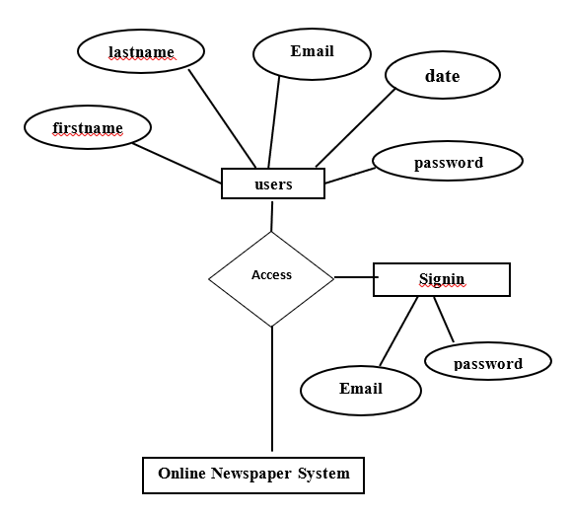
E-R DIAGRAM

Slide 11
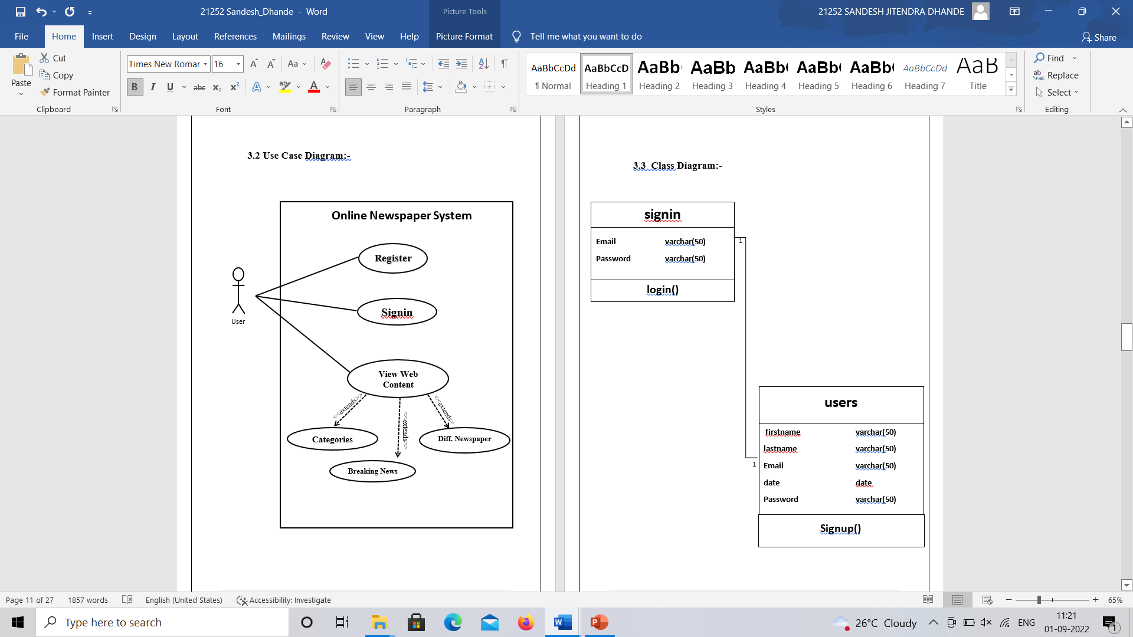
Use Case Diagram

Slide 12
Class Diagram

Slide 13
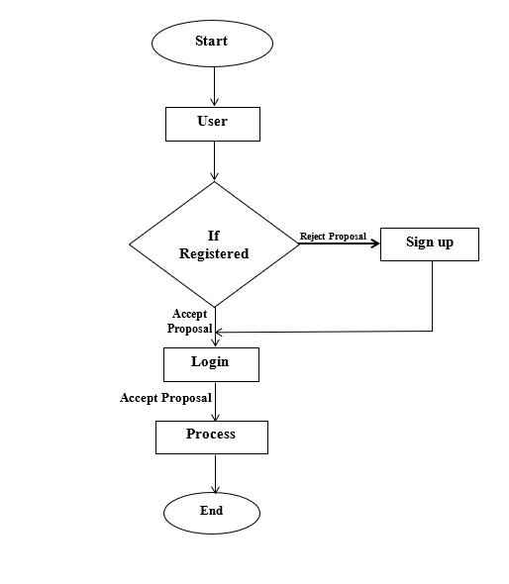
Activity Diagram

Slide 14
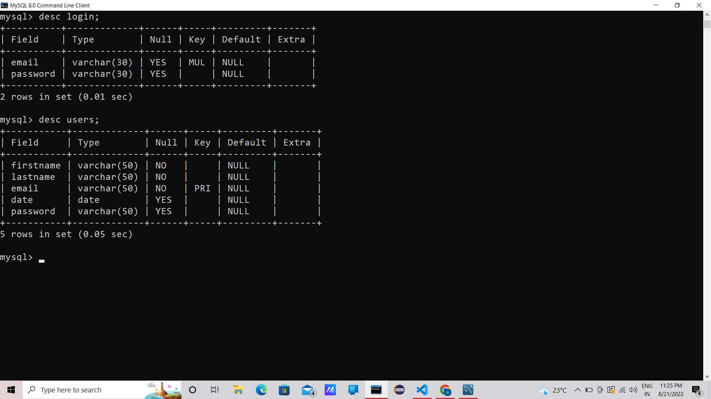
Table Structure
users

Slide 15
Signin

Slide 16
User Interface Design
4

Slide 17
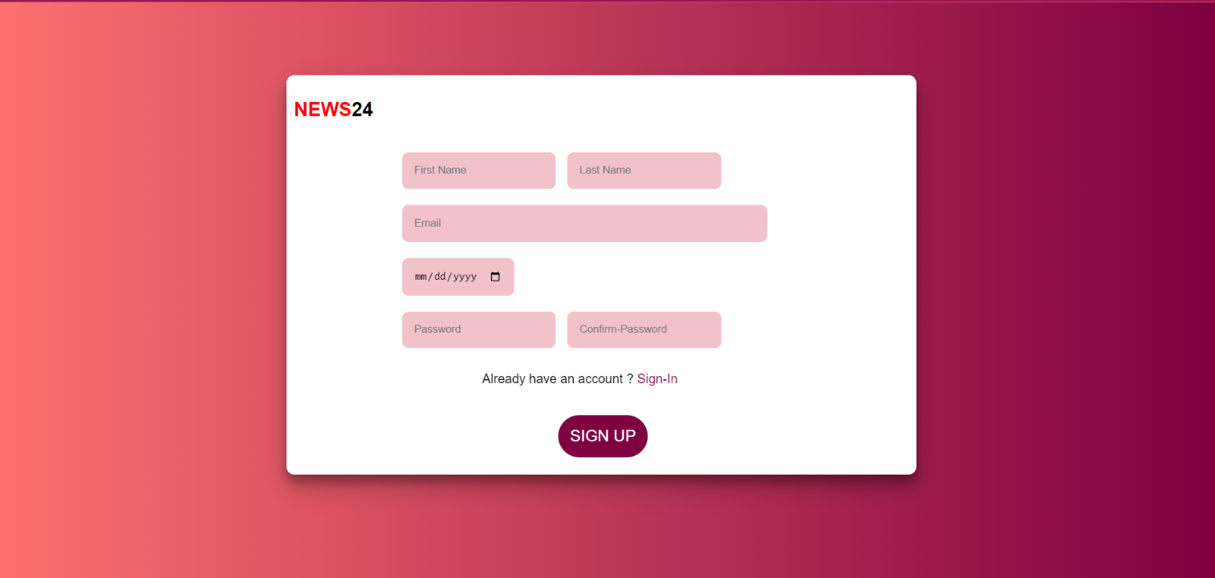
Registration Page

Slide 18
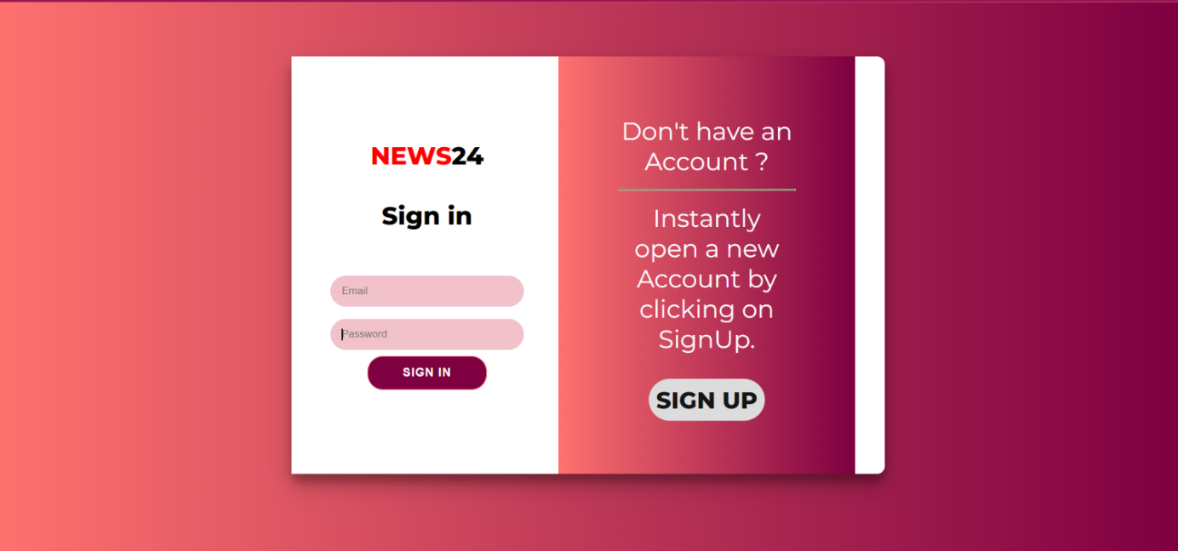
Sign-in Page

Slide 19
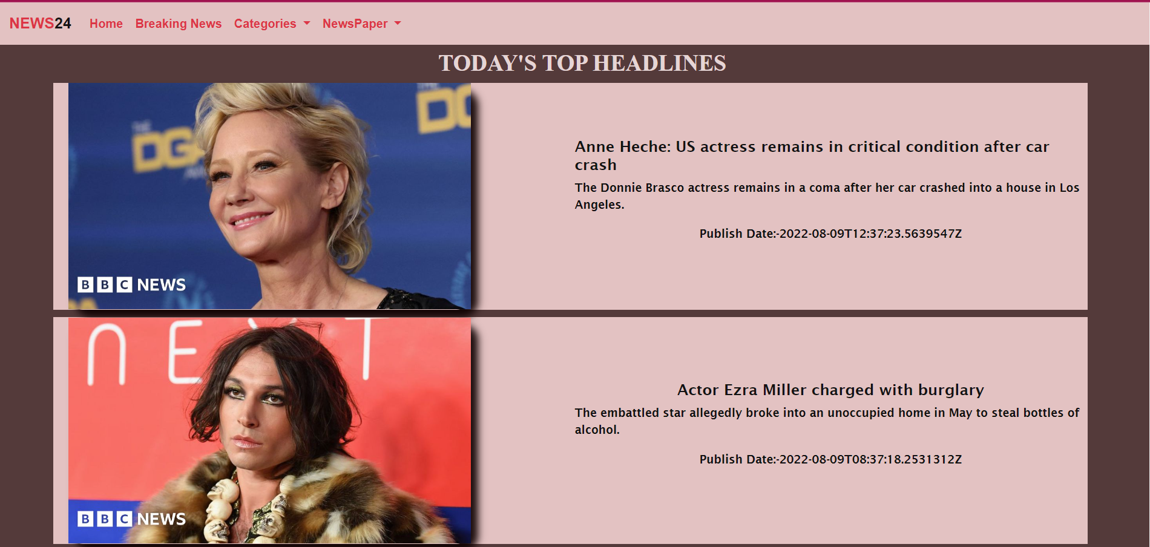
Home Page

Slide 20
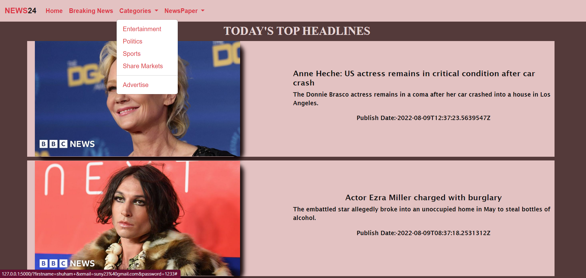
Categories

Slide 21
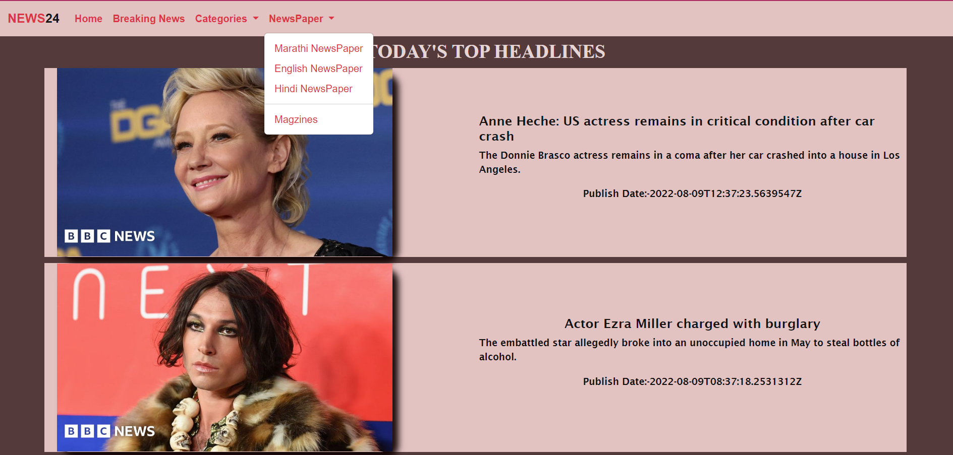
Newspaper: diff. Languages

Slide 22
Conclusion
5

Slide 23
Post Implementation
The explosion of readily available news and information on the web has, at least in part, eclipsed the long-held role of daily newspapers to deliver the news, but has yet to touch their unique contribution to the American democratic process: the ability to explore in depth highly complex subjects of public interest

Slide 24
Limitation
6

Slide 25
Limitation
Online papers have not figured out a way to make the money from advertising that print does. That means they have no money to pay writers and editors. The result: less high-quality reporting, writing and editing.
Conversely, you may get ink all over your hands and you may have a hard time reading a paper on an airplane but print is what makes the advertising dollars needed to keep the paper in business.

Slide 26
Reference
7

Slide 27
www.W3School.com
www.javapoint.com
www.Geeksforgeeks.com

Slide 28
Thanks!
Any questions?

